Slide 1

Stormwater/Wastewater Project Advisory Committee (PAC)
December 5, 2023

Slide 2
Agenda
Introductions Leland Koester 3:00 PM – 3:10 PM
Overview/Agenda Chip Ullstad 3:10 PM – 3:15 PM
Policy Question Chip Ullstad 3:15PM – 3:20 PM
  Rate structure options
GIS methodology Christina Conchilla 3:20 PM – 3:40 PM
Discussion/Questions All
Revenue requirements Chip Ullstad 3:40 PM – 3:50 PM
Discussion/Questions All
Rate options, comparison, Deb Galardi 3:50 PM – 4:15 PM
example rates
Discussion/Questions All 4:15 PM – 4:55 PM
Next Steps Chip Ullstad 4:55 PM – 5:00 PM

Slide 3
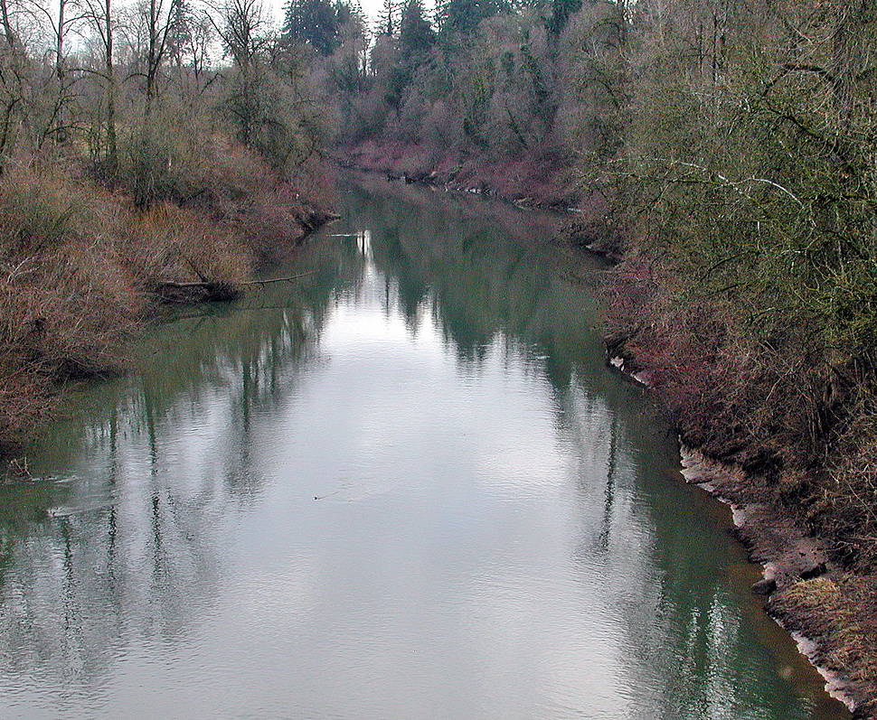

City of McMinnville
Impervious Area Data Development
Stormwater/Wastewater Advisory Committee
December 5, 2023

Slide 4
GIS Methodology
Impervious Area
SFR Properties
ERU Determination
SFA Properties
NSFR Properties
Units of Service
Questions?
Notes:
Add background scope review slide – this is where we are

Slide 5
Impervious Area

Slide 6
Impervious Area (IA)
Hard surfaces that don’t allow infiltration of stormwater into the ground. Examples include:
          Rooftops
          Driveways
          Patios
          Private Sidewalks
          Parking Lots
          Compacted gravel
    Excluded: swimming pool water, railroad ballast, open graded aggregate and landscaping gravel
    Most commonly used metric for stormwater billing
Notes:
Impervious surface area is the most commonly used metric across the United States to charge for costs related to stormwater services. The more impervious area on a property, the more stormwater the property generates and the greater the demand for City stormwater services.

Slide 7


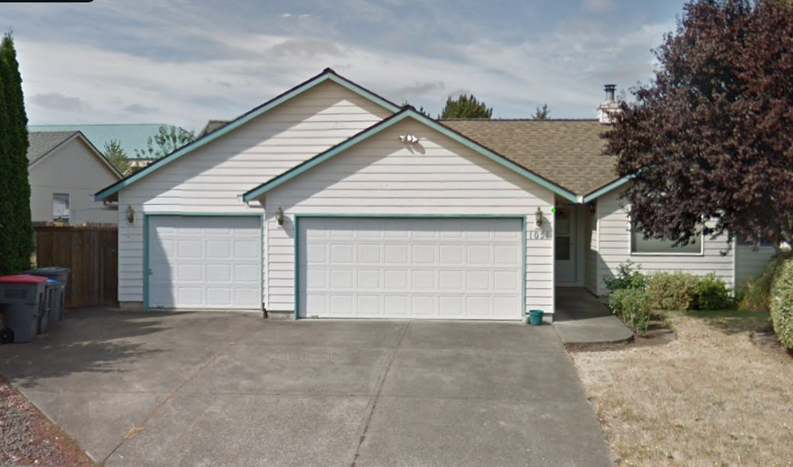

Equivalent Residential Unit (ERU)
Billing unit for IA based rate structures
Community specific
Median IA on Single-family residential (SFR) properties
Notes:
Measure of the typical amount of impervious area on single-family residential property.

Slide 8
SFR Properties

Slide 9
Single-Family Residential
One building on one parcel that contains one or two dwelling units.
Yamhill County Tax Parcel Data
10,136 SFR properties in McMinnville including the following land use codes: 101, 109, 111, 121, 191, 207, 401, 409, 451, 551
101 also has some SFA properties that were not included
207 also has some mobile home/manufactured home parks that were not included

Slide 10
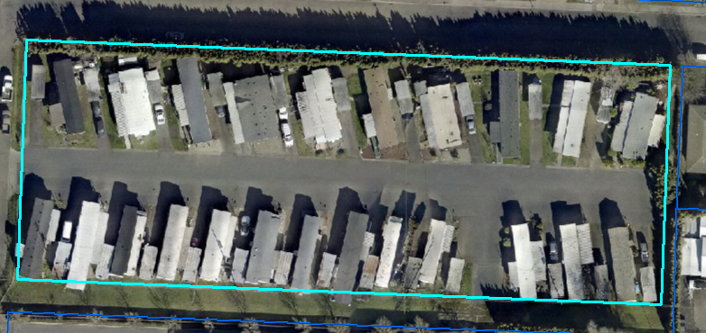
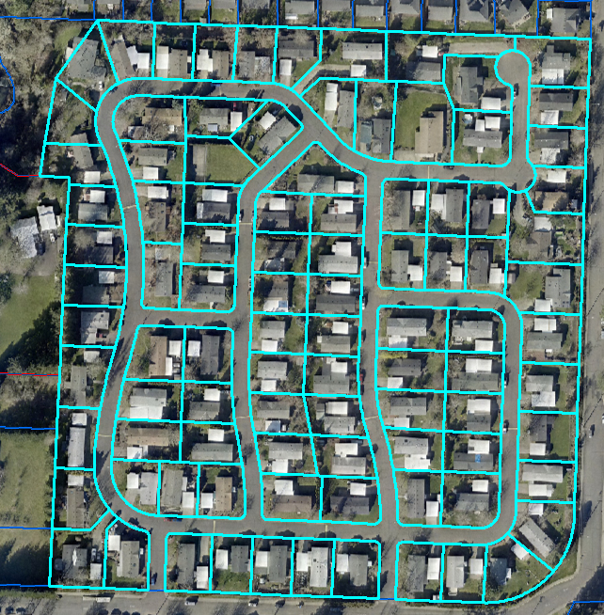
Mobile Home/Manufactured Home Properties
One home per parcel – SFR
More than one home per parcel – Non-single-family residential (NSFR)

Slide 11
ERU Determination

Slide 12
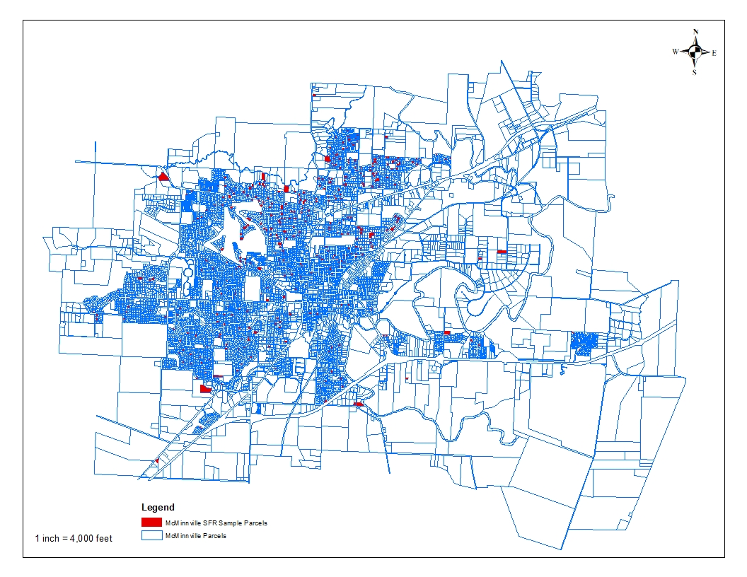
Impervious Area Digitization
Using ArcGIS, measured IA on a random sample 400 properties
Representative range of geographies, structure ages, and housing types within the City

Slide 13
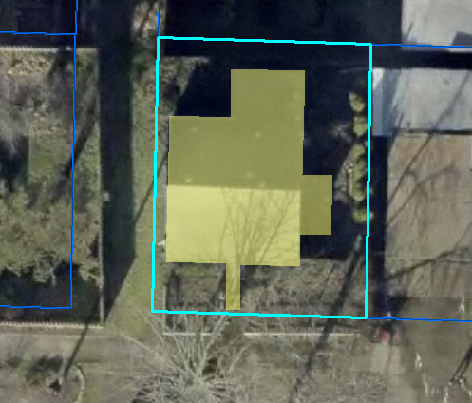
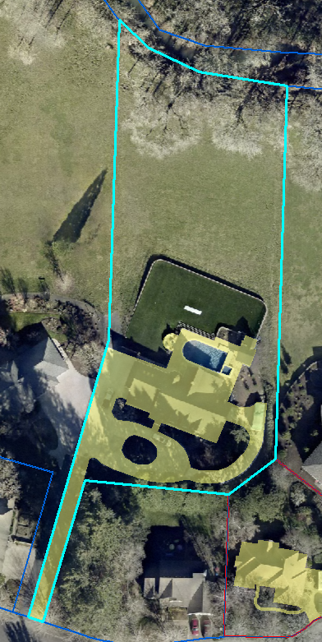
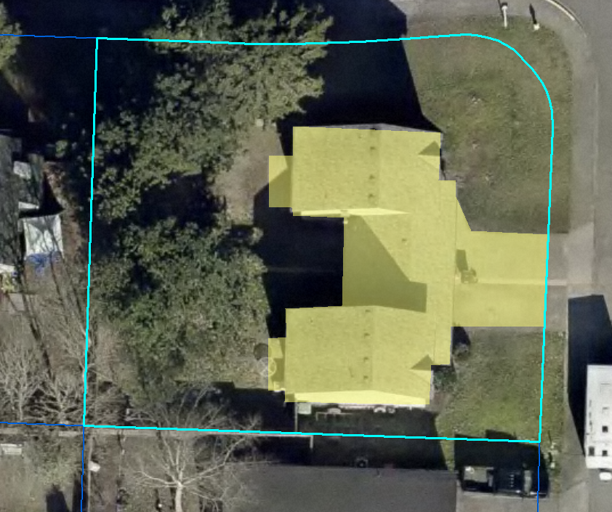
Impervious Area Examples
Notes:
Minimum IA: 858 sq. ft.
Maximum IA: 15970 sq. ft.

Slide 14
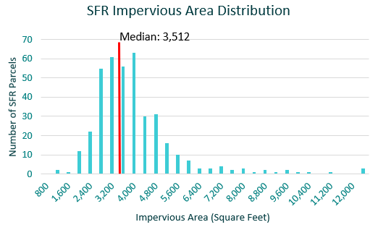
Histogram
For ease of billing administration and customer understanding – will round ERU to 3,500 square feet

Slide 15
SFA Properties

Slide 16
SFA Properties
Yamhill County Tax Parcel Data
286 SFA properties in McMinnville including the following land use codes: 101, 102 and 003 (common area)
9 different SFA communities
Each community was assigned a parent parcel ID to count total parcels and common area parcels and to sum the measured IA

Slide 17
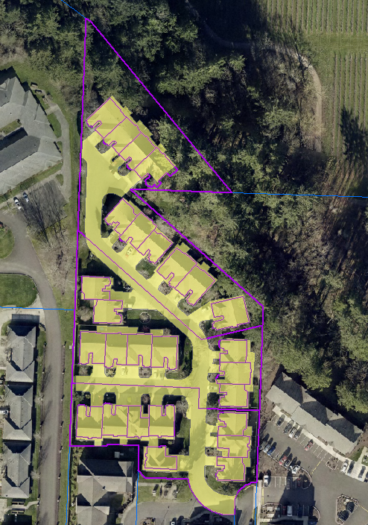
Single-Family Attached (SFA) Properties
Attached units located on individual parcels – often smaller than SFR parcels
Share common area IA
Impervious area for SFA properties and common areas was measured
Notes:
This example community has 30 parcels total with 3 common area parcels and a total IA of almost 92k square feet.

Slide 18
2 Billing Options for SFA Properties
Bill like NSFR properties: total measured IA/ERU value = total ERUs. Allocate ERUs equally amongst meters.
Bill by Class per Unit ERU Value: Measured IA is divided by the number of units. Then further divided by ERU value for a per unit ERU value. Average per unit ERU value for all SFA properties (0.7 ERU per Unit)

Slide 19
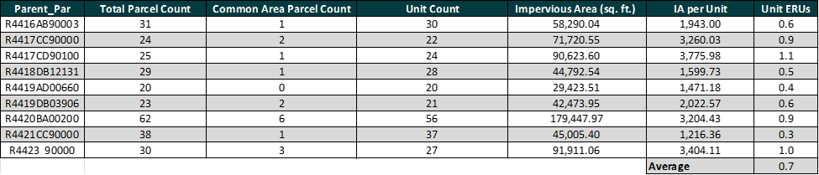
SFA - IA Measurement Data

Slide 20
NSFR Parcels

Slide 21
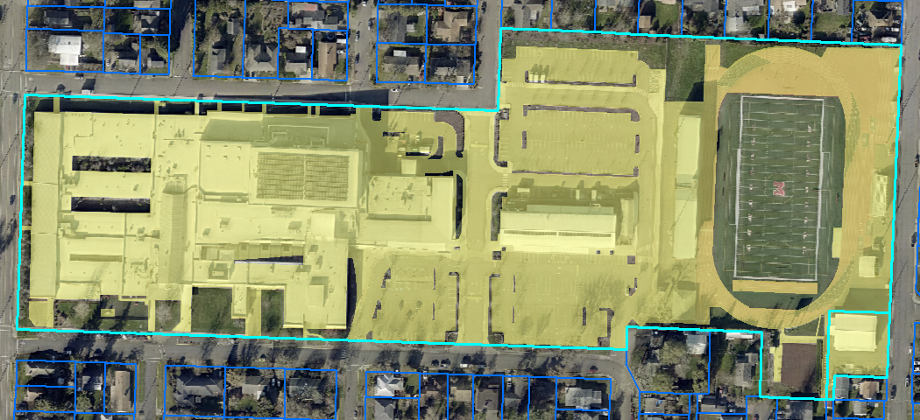
Non-Single Family Residential (NSFR) Properties
1,613 NSFR Parcels in McMinnville – 1,469 developed with IA
Total IA divided by ERU value to calculate billable ERUs

Slide 22
Units of Service

Slide 23
Units of Service
Billing units for the proposed Stormwater Utility:
        SFR - 1 ERU each
        SFA - 0.7 ERU each
        NSFR - IA/divided by 3,500 then rounded up to the nearest whole integer value (policy question for February 2024 meeting)
        No bill for parcels with under 350 sq. ft. of IA value (policy question for February 2024 meeting)
Notes:
Look at properties with low IA – how many are there and how many have adjacent same owners?

Slide 24
QA
&
24

Slide 25
Q
Revenue Requirements
25

Slide 26
26

Slide 27
QA
&
27

Slide 28


STORMWATER RATE STRUCTURE DEVELOPMENT
Project Advisory Committee Meeting
December 5, 2023

Slide 29
Rate Setting Principles & Practices
Set rates by class
Balance equity and administration costs
Charge in proportion to system “use” or impact (service received)
* Hard surfaces that don’t allow infiltration of stormwater into the ground.

Slide 30
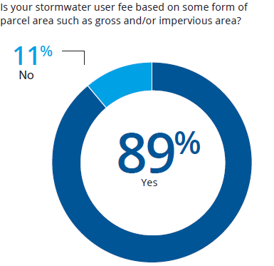
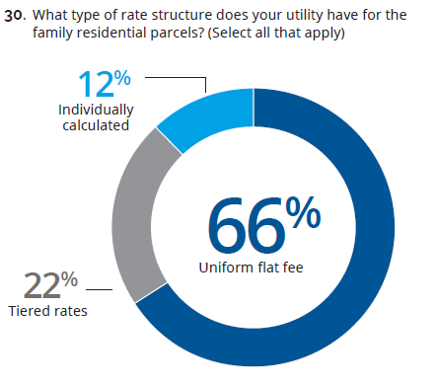
Rate Structures (Nationally)
Source: 2021 Black & Veatch Stormwater Survey

Slide 31



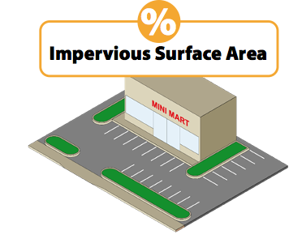


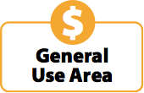



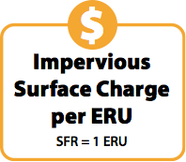
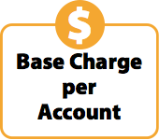


Rate Option Development
Option 1: 100% Costs based on ERUs
Base Costs
Option 2: ERU + Base Charge
ERU = Equivalent Residential Unit, SFR = Single Family Residential, NSFR = Non-single family residential

Slide 32
Preliminary Rate and Bill Calculations
All rates and bills are preliminary
Factors affecting ERU estimates
  Refinements to impervious area measurements for individual properties (customer driven)
  Policy decisions regarding exemptions and credits
Factors affecting revenue requirements
  Stormwater billing costs from McMinnville Water & Light
  City indirect cost allocations developed through 2024-25 budget process
ERU = Equivalent Residential Unit,

Slide 33
Rate Option 1
100% annual costs scaled based on ERUs.
ERUs adjusted down 5% to reflect estimated credits and impervious area adjustments.
ERU = Equivalent Residential Unit

Slide 34
Rate Option 2
Base charge = estimated billing costs (4% annual costs)
ERU Charge = other costs (96% annual costs)
Franchise fees (6% charge on total revenue generated)
  Split between base and ERU charge (4%/96%)
ERU = Equivalent Residential Unit, SFR = Single Family Residential

Slide 35
Sample Bills
Option 2 results in +$0.70/month increase for single unit residential and a 3-4% reduction for measured ERU customers.
*Updated to reflect ERU Rounding

Slide 36
Non-Single Family Residential Monthly Bills Histogram

Slide 37
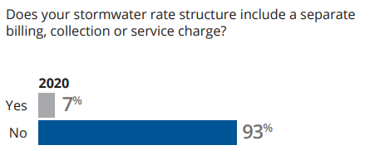
Preliminary Rate Structure Evaluation
Source: 2021 Black & Veatch Stormwater Survey
Sample Oregon cities with stormwater base charges: Eugene, Salem, Albany

Slide 39
Rate Program Elements
Rate Structure
  Option 1: ERU Only (Recommended)
  Option 2: ERU +Base
Rate Modifiers & Policies (Next meeting)
  Exemptions/discounts
  Stormwater credit program
  Appeals & billing procedures
Rate Structure
Rate Modifiers
Billing Policies

Slide 40
QA
&
40

Slide 41
Q
Next Steps
February 2023: Discussion/Recommendations of Rate Modifiers (credits/discounts)
March 2023: Hold community meeting to discuss the Stormwater Utility
April 2023: Present recommendations to City Council at a work session
May 2023: City Council considers adoption of a Stormwater Utility Committee begins discussion of sewer utility rates and SDCs
August 2023: If adopted by City Council, begin billing for Stormwater Utility
41

